Slide 1
Credit Card Approval Prediction
Group 6
Iris Gu, Sarah Wang, Yuxin Tang
Notes:
We designed our presentation kind of like storytelling, and won’t focus too much on code.

Slide 2
Why did we pick it?
Notes:
Let’s start with the reason why we pick this topic.

Slide 3

Close to real life
How banks evaluate applicants’ profile
Notes:
The reason is pretty simply. The use of credit card is pretty close to our real life. I believe most of you have applied for a credit card in the past and i guess the banker, in most situations, would never tell you immediately about whether you get approved. In some cases, it takes only one or two days to be approved, but in other cases, it might take longer such as 2 weeks. So we picked this topic because we are interested in how bank evaluates credit card applicants based on their different backgrounds and personal information.

Slide 4
Why is it important for business?
Notes:
Definitely, Credit card approval prediction is quite important for businesses.

Slide 5

Avoid potential risk
Minimize loss
Expedite receivables collections
Reduce bad debts
Increase liquidity
Notes:
One of the reasons is pretty obvious, which is to avoid some potential risk. For example, if a bank does not have a correct model to predict this, they might issue credit cards to people who have a bad FICO score or who cannot afford to pay off their balance timely. But if the bank does have a model with a relatively good performance, their loss can be minimized

Slide 6
Why is it a hard problem?

Slide 7

Fluctuated financial markets
Flexible credit policy
Covid
Notes:
In reality, it is a hard problem since the financial markets are constantly changing and fluctuating, same as the credit policy. So the model needs to be adjusted in accordance with present policies. For instance, during covid times there were less people applying for credit cards because of financial hardship and reduced purchasing power, so in response to this, some banks wanted to tighten their standards of issuing a card since they didn’t want to take more risks. But now after covid, some banks might want to loosen their standards to encourage purchase. So in this case, the threshold in the model of deciding whether a person can be approved needs to be adjusted accordingly.

Slide 8
Our story begins…
Notes:
Now, let’s focus more on our model.

Slide 9
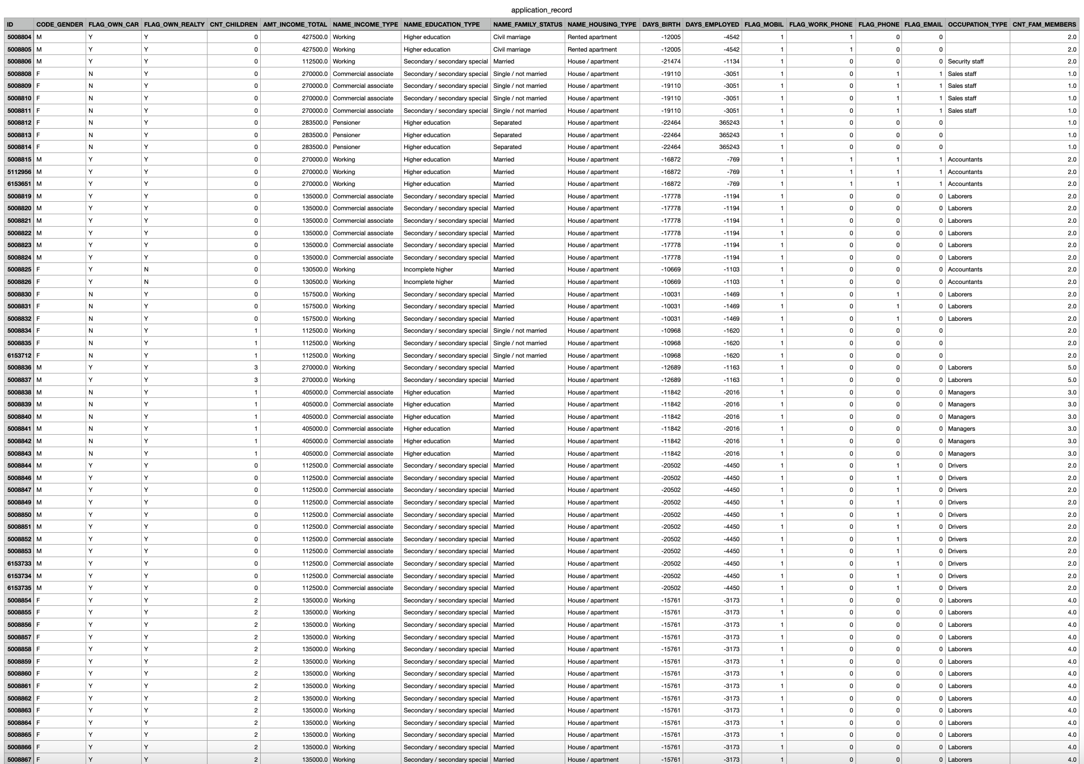
Dataset ①：
Features
https://www.kaggle.com/datasets/rikdifos/credit-card-approval-prediction
Notes:
We have two datasets. For our feature dataset, we found two “interesting” things when we were doing our exploratory data analysis.

Slide 10
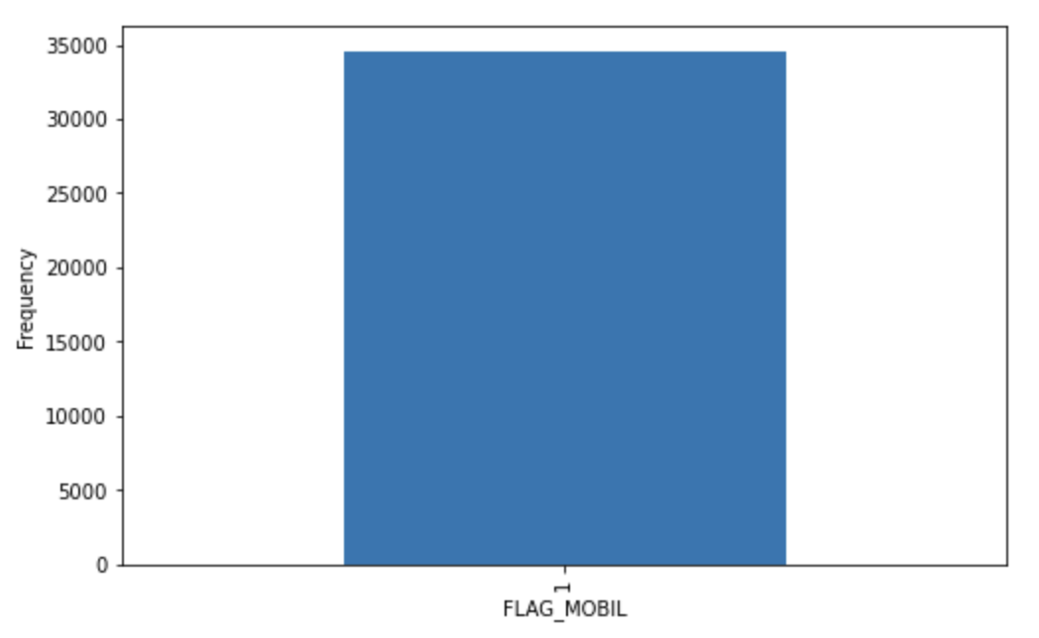
438557 rows * 17 columns
EDA
Statistics Analysis
Outliers
Notes:
one is that when we plot the graph for each feature, we found out that for the feature flag_mobil, which means if the person owns a mobile phone, there was only data with a value of 1. This means everyone in this dataset has a mobile phone, and as a result, we dropped this feature from our model.

Slide 11
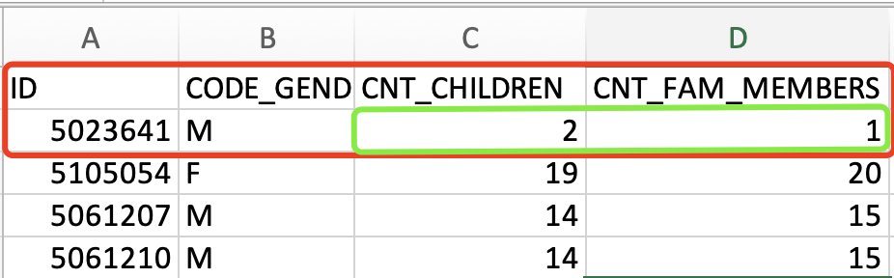
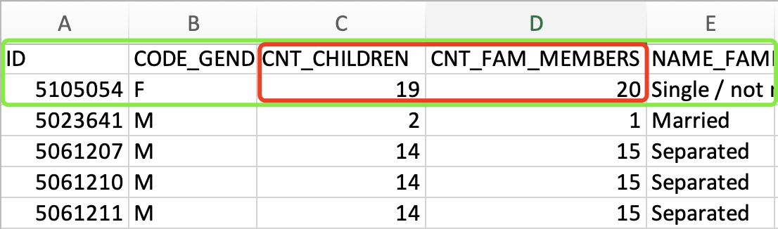
EDA
Statistics Analysis
Outliers
Notes:
Second unique thing we found when we tried to remove outliers is that some people have multiple children, but they are not married. As the screenshot shown here, one person has 19 children, but the marital status is single/not married. This seems to be strange to us at first, but considered this is a real dataset, we did some research out of curiosity to try to rationalize this piece of data, and we found out that there is some possibility of adopting kids for single people or unmarried couples. Since This is an example of outlier, and we dropped this when building our model.

Slide 12
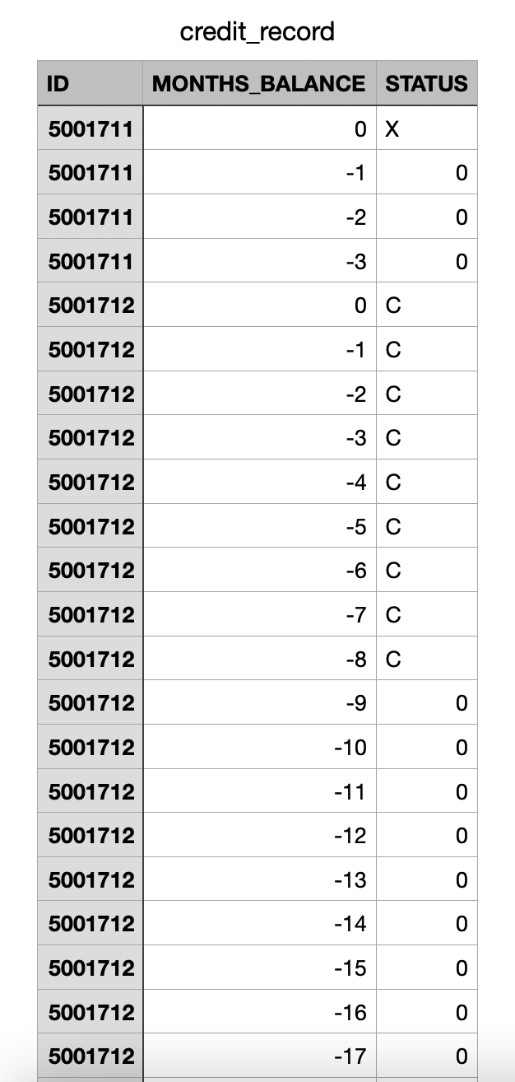
Dataset ②：
Target
https://www.kaggle.com/datasets/rikdifos/credit-card-approval-prediction
Notes:
Our second dataset is about target. We got a challenge at first because we don’t have a given target. We spent some time trying to figure out what we can do. what we actually did is that we use the column “status” to create the target. “status” contains both categorical and numeric values, and it represents whether a person paid off each month and if not, how long does the person past the due date.

Slide 13
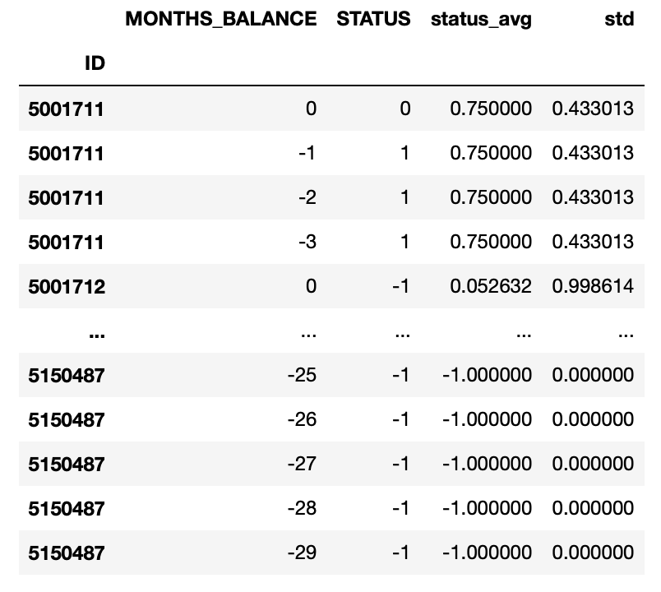
3 types in “STATUS”
Assign values
Calculate average & std
Notes:
we assigned some numbers to categorical values since it is easier to calculate, and we averaged the sum of each person’s monthly status to get the final value of the target. The higher the target value is, the longer the person has passed the due date. Now iris will take it from here.

Slide 14
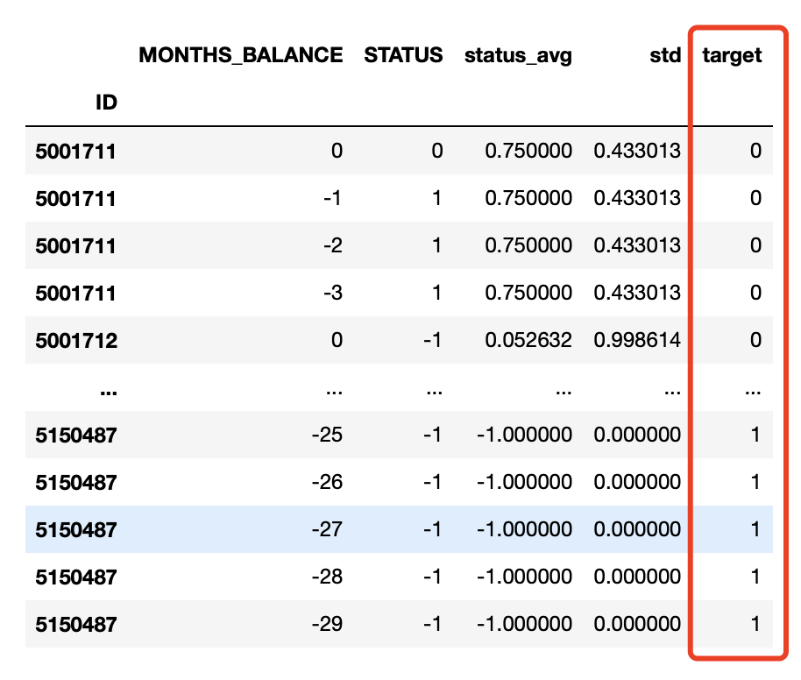
Classification
Notes:
Here comes the part of modeling.
The first kind of model that came into our mind is classification. For credit approval, we wanna know if a person can be approved or not.
We have transformed the original credit record data into status_avg and std. But to train a model, there needs to be a target. Let 0 represent not to be approved and 1 represent to be approved. One thing we can do is to split customers into that two groups according to their status_avg. Here we take 0 as the threshold, if one's status_avg is smaller or equal to 0, which means he or she did not have a loan or was always paid off in time, we would like to approve, and vice versa.
Here comes an interesting point of our project, as Sarah mentioned, a bank needs a flexible policy, so just because we do not have a given target, and what we have is exactly that metadata from a commercial bank, thus we could build models with changeable criteria. If a bank is competing with another one and wanna expand its market share, maybe it can change that threshold from 0 to 0.5.

Slide 15
LogisticRegression
Stratify or not
Performance on Different groups
Female
Stratify
Male
On whole dataset
Female
Not Stratify
Male
Almost the same!
Notes:
So what we are gonna do now is to put those features and the target into Logistic Regression.
Considering there are a lot of categorical features, and our target is also categorical, the imbalance is a big question. Is our model fair enough for different groups? To test that, we chose an imbalanced feature, gender, to train both a stratified and non-stratified model.
And we couldn't be happier seeing the results for different groups are almost the same! So are the performances on train and test set.

Slide 16
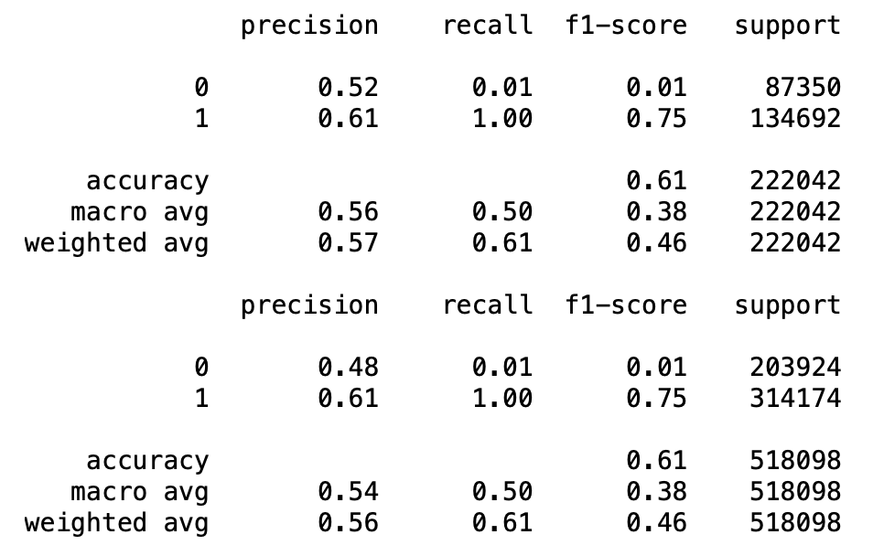
Notes:
But hold on, looking at that report, something must be wrong.

Slide 19


Notes:
The f1-score of 0 is almost 0 on both the training and testing set.
This is perfectly imperfect.
We thought it might be caused by underfitting, cause we had too much data but trained with a model that is too simple.

Slide 20
RandomForestClassifier
Stratify or not
Performance on Different groups
O: 0.75 ; 1: 0.85
Oversample 0 using Resample
0: 0.76 ; 1: 0.83
Notes:
Then, we moved on to the Random Forest Classifier. Here we added one more trial, we oversampled the amount of 0. Performance became much better. We had a similar and good performance on different genders and also on different types of targets, 0 and 1.

Slide 21
Regression
❎
MSE of status_avg: 0.6151364884421742
Notes:
So now, the question is, can we do better? As we mentioned, flexibility is very important, so can we use a regression model to give out a grade for each person, other than just 0 or 1?
Imagine we input Sarah’s profile to a model, and the output is "The credit score of Sarah is 99", then not only can we know whether or not Sarah can be approved for a credit card, but also we can know how good Sarah's credit is. This may help a bank in follow-up changes of credit limit.
But the time we turned to regression, even the Random Forest Regressor did not have a good performance.

Slide 22

Demo:
http://127.0.0.1:5000/predict?_x=-3000
Notes:
So our optimal model is still the Random Forest Classifier, we did a grid search to select the best parameters, and here is the demo of our model. We have given the model some information in advance, and now let's try a numerical feature together: days of employed, negative cause it counts backward. Trying -3000, we assume there is a person who has worked for about 8 years. And here we get the prediction, it's a 1, meaning this person can be approved.

Slide 23
Further Exploration if more time
Time series problem
Now: average of monthly status
Future: Weighted average of monthly status
Standard deviation
Notes:
Last but not least, if we have more time, we wish to do some further exploration on these two parts. Now we only use an average of monthly status to decide a person's credit status, maybe a weighted average will be better.
Also, though we have calculated the std of a person's monthly status during a period, we have not come up with an idea of how to combine it with that average yet.

Slide 24


Thank you!

